Slide 1
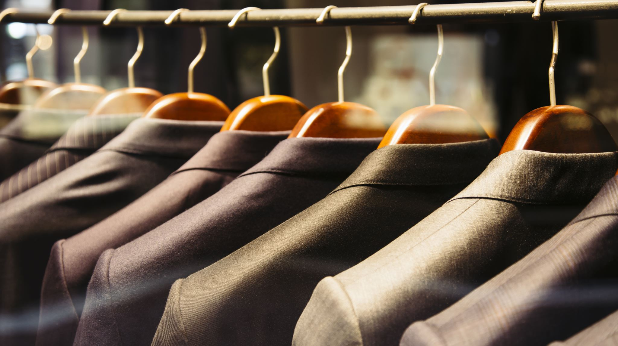
AI iN Fashion
By:
V Abhinav Reddy(12100397)
Ashish Bharti(12109333)
Ramavath Sanjay(12113173)

Slide 2
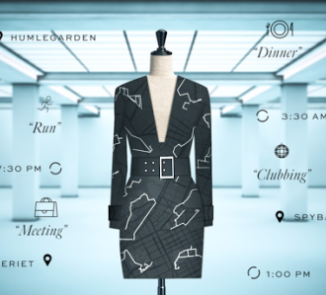
Introduction
Artificial Intelligence (AI) is rapidly transforming the fashion industry in various ways, including improving the efficiency of the supply chain, enhancing the customer experience, and enabling the creation of more sustainable and ethical fashion products.
One significant application of AI in fashion is through the use of machine learning algorithms to analyze and interpret consumer data to provide insights into consumer preferences and behaviors. Retailers can use this data to better understand their customers and create personalized shopping experiences, tailor marketing campaigns, and improve product design and development.

Slide 3
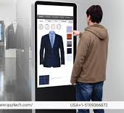
AI in Fashion - Examples
Virtual Try-Ons: AI-powered virtual try-on tools are being used by many fashion retailers to help customers try on clothes virtually. This allows customers to see how an outfit will look on them without having to physically try it on. For example, H&M uses an AR-based virtual try-on tool in their app to allow customers to see how a piece of clothing will look on them before purchasing.
Supply Chain Optimization: AI can be used to optimize supply chain management in the fashion industry. For example, it can be used to analyze demand forecasting data and optimize inventory management. It can also be used to analyze production and logistics data to optimize the supply chain and reduce costs. For example, Zara uses AI to analyze real-time sales data and production lead times to optimize their supply chain and reduce lead times.

Slide 4
Benefits of Ai in Fashion
There are many benefits of AI in the fashion industry, including increased efficiency, cost savings, and improved customer experiences. Here are some of the main benefits:
Increased Efficiency: Alibaba's FashionAI is an AI-powered virtual stylist that recommends outfits based on a shopper's preferences and body type. This AI tool helps shoppers discover items that they would be interested in buying and saves their time from browsing through numerous products. Moreover, the chatbots equipped with Natural Language Processing (NLP) technology can handle customer inquiries, order tracking, and provide fashion advice 24/7, thereby increasing the efficiency of customer service.
Cost Savings: Tommy Hilfiger has used AI to optimize their production processes and reduce waste. By analyzing production data and identifying areas for improvement, Tommy Hilfiger was able to reduce their fabric waste by 35% and save an estimated $18 million in 2018.
Improved Customer Experiences: Levi's has used AI-powered chatbots to improve customer service and support. The chatbots use natural language processing to understand customer inquiries and provide personalized recommendations and assistance. As a result, Levi's has been able to provide faster and more efficient customer service, improving the overall customer experience.

Slide 5
Challenges of AI in Fashion
Data Privacy Concerns: AI systems rely on vast amounts of data to operate effectively. However, collecting and processing this data can raise concerns about data privacy and security. To address these concerns, companies like Levi's have developed privacy policies that are transparent and clearly communicated to their customers. They also ensure that the data they collect is anonymized, and they provide customers with the option to opt-out of data collection.
Bias in Algorithms: AI systems can inherit biases from the data they are trained on, leading to unfair and discriminatory outcomes. To address this issue, companies like Amazon have developed tools to detect and mitigate bias in their algorithms. For example, they have created a machine learning tool called Amazon SageMaker that can detect biases in algorithms and provide recommendations for mitigating them.
Sustainability: The environmental impact of AI is another challenge in the fashion industry. AI relies on significant computing power, which can lead to increased energy consumption and carbon emissions. To address this issue, companies like Google have pledged to achieve carbon neutrality by 2020 and use renewable energy sources for their data centers.

Slide 6
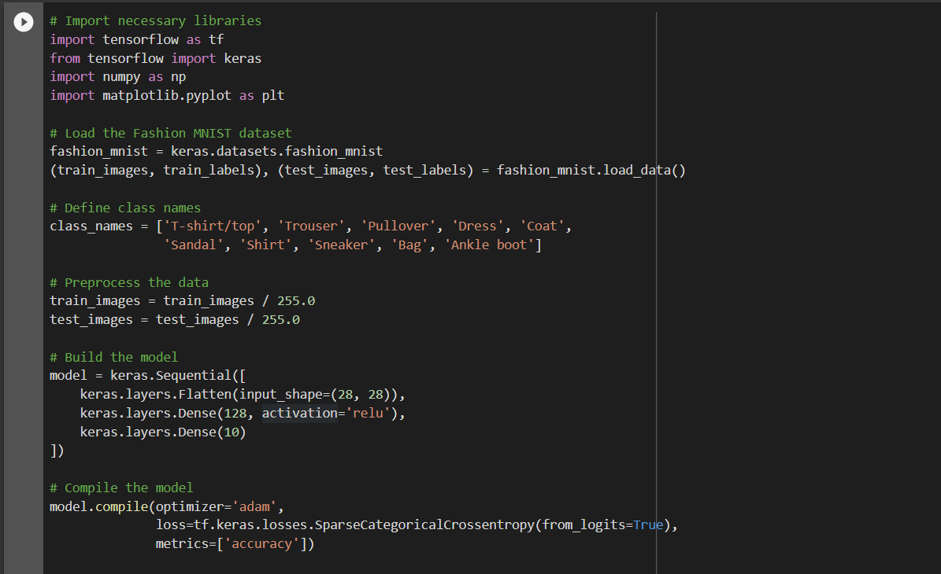
Code:

Slide 7
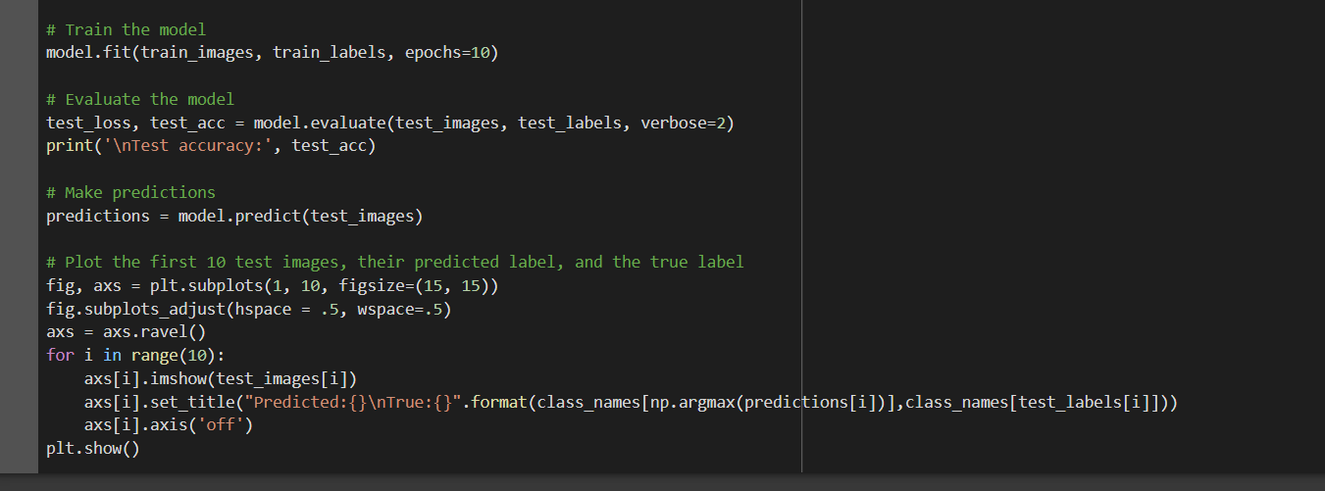

Slide 8
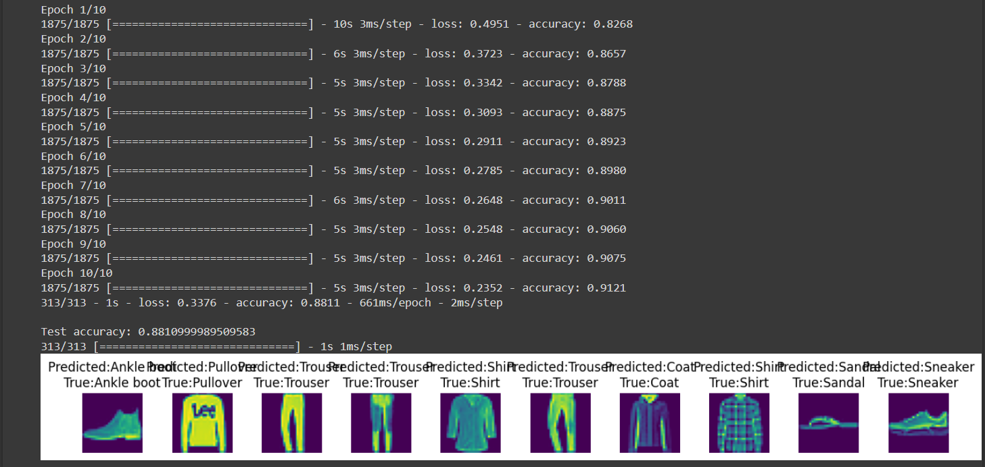
Output

Slide 9
Code Explanation
This code uses TensorFlow to build and train a neural network to classify images of clothing from the Fashion MNIST dataset. Here is an overview of each section:
This code uses TensorFlow to build and train a neural network to classify images of clothing from the Fashion MNIST dataset. Here is an overview of each section:
Import necessary libraries: The code imports TensorFlow, Keras (a high-level API for building and training neural networks), NumPy (a library for numerical computing), and Matplotlib (a library for plotting graphs and charts).
Load the Fashion MNIST dataset: This code loads the Fashion MNIST dataset, which consists of 70,000 grayscale images of clothing items in 10 categories.
Define class names: The code defines a list of class names corresponding to the 10 categories in the dataset.
Preprocess the data: This code scales the pixel values of the images between 0 and 1 to normalize them.
Build the model: This code defines a sequential neural network with two layers: a flattened input layer and a dense layer with 128 neurons and a ReLU activation function.

Slide 10
Compile the model: This code compiles the model using the Adam optimizer, SparseCategoricalCrossentropy loss function, and accuracy as the evaluation metric.
Train the model: This code trains the model using the training data for 10 epochs.
Evaluate the model: This code evaluates the model's performance on the test data and prints the test accuracy.
Make predictions: This code uses the trained model to make predictions on the test images.
Plot the results: This code plots the first 10 test images, their predicted labels, and the true labels using Matplotlib.
The output of this code is a plot of the first 10 test images with their predicted and true labels displayed underneath them. The accuracy of the model on the test set is also printed.

Slide 11
Fashion MNIST Dataset
Fashion MNIST is a dataset of images that is commonly used in computer vision and machine learning research. It consists of 70,000 grayscale images of 28x28 pixels, each representing a different clothing item or accessory. The dataset includes 10 different classes of clothing, including T-shirts, trousers, sneakers, dresses, and more.
In the code, the Fashion MNIST dataset is used to train and test a neural network to classify the different types of clothing items. The images in the dataset are preprocessed to ensure that they are all the same size and are normalized to improve the performance of the neural network. The dataset is split into training and testing sets, with 60,000 images used for training and 10,000 images used for testing. The neural network is trained using the training set and then evaluated using the testing set to measure its accuracy in classifying the different types of clothing. The Fashion MNIST dataset is a useful tool for researchers and developers to test and develop their machine learning models for fashion-related tasks.

Slide 12
Conclusion
In this presentation, we discussed the role of AI in the fashion industry. We highlighted some of the benefits of AI in fashion, such as increased efficiency, cost savings, and improved customer experiences, and provided specific examples of how these benefits have been realized in the industry. We also discussed some of the challenges of implementing AI in fashion, such as data privacy concerns, bias in algorithms, and technological barriers, and provided specific examples of how these challenges have been addressed by industry leaders.
Looking to the future, AI is expected to continue to play a significant role in the fashion industry. We can expect to see further advancements in the development of AI-powered tools, such as virtual try-on and product recommendation systems, that will enhance the customer experience and improve operational efficiency. Additionally, AI can be used to improve sustainability in the fashion industry by optimizing the supply chain, reducing waste, and lowering carbon emissions.
Overall, AI has already begun to revolutionize the fashion industry, and we can expect to see even more exciting developments in the years to come. By embracing AI and addressing the challenges that come with its implementation, the fashion industry can continue to grow and innovate in exciting new ways.

